Slide 1
HELLO PERFECT BEGINNERS TRAINING SESSION
1ST JUNE, 2026
11am -1pm

Slide 2
SKIN SCIENCE AND CLINICAL FOUNDATION
FACILITATOR: Dr Deborah Suleman
Consultant Physician and Dermatologist

Slide 3
OUTLINED TOPICS
The skin as a system (Anatomy & physiology)
The skin barrier
Skin diversity and Fitzpatrick scale
Inflammation, histamine and immune response
Pigmentation
Acne (types)
Wound healing
Contraindications

Slide 4
ANATOMY AND PHYSIOLOGY OF THE SKIN:BASIC OVERVIEW

Slide 5
INTRODUCTION
The skin is one of the largest organs in the body, having a surface area of 1.8 m² and making up about 16% of body weight.
It varies in thickness across anatomic location, sex, and age of the individual.
Skin is thickest on the palms and soles of the feet (1.5 mm thick), while the thinnest skin is found on the eyelids and in the post auricular region (0.05 mm thick).
Male skin is characteristically thicker than female skin in all anatomic locations.

Slide 6
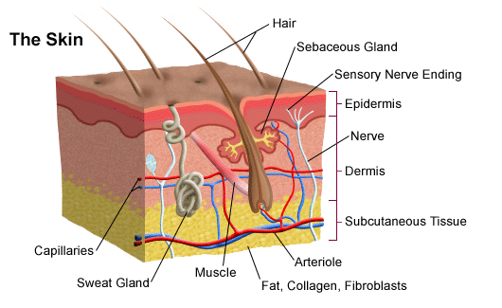

Slide 7
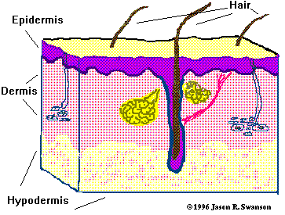
LAYERS OF THE SKIN
Epidermis:
Composed of keratinized stratified squamous epithelium.
Dermis:
Papillary region composed of loose connective tissue.
Reticular region composed of dense irregular connective tissue.
Hypodermis:
Composed of areolar tissue with abundant adipocytes.

Slide 8
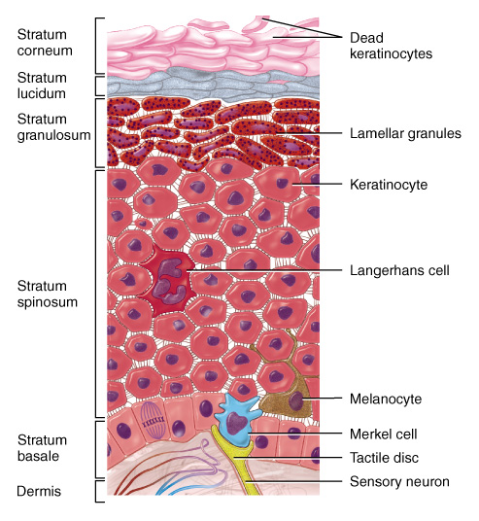
EPIDERMAL LAYERS
Stratum Corneum:
Composed of structureless dehydrated dead cells.
Flattened & scale-like.
Filled with keratin.
Superficial layer is continuously sloughed off.
Stratum Lucidum:
Seen only in non-hairy or thick skin.
Cells are flattened, translucent, eosinophilic with indistinct boundaries & nucleus.
Contains a product of keratohyaline i.e. eleidin.

Slide 9
Stratum Granulosum:
3-5 layers of flattened polygonal cells.
Cells contain keratohyaline granules.
Stratum Spinosum:
Several layers of polygonal cells.
Cells are held together by desmosomes.
Stratum Basale (Germinal/ Malpighian layer):
Single layer of cuboidal cells resting on basement membrane.
High mitotic activity.

Slide 10
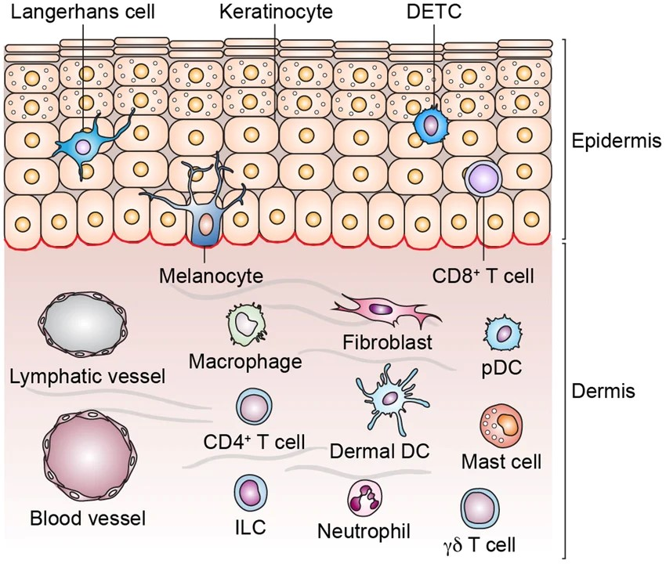
SPECIALIZED CELLS OF THE EPIDERMIS
Keratinocytes
Melanocytes
Langerhans cells
Merkel cells

Slide 11
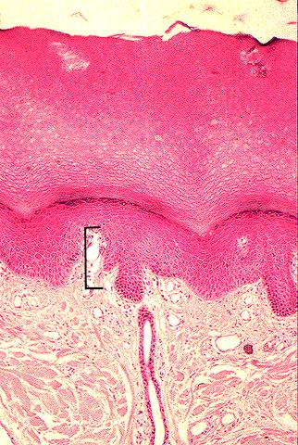
DERMAL LAYERS
Papillary layer:
-Narrow band of loose connective tissue.
-In contact with basement membrane of stratum basale.
-Dermal papillae (finger- like processes)
Reticular layer:
-Dense irregular connective tissue.
-Thick elastic fibres.
Dermal papillae
Reticular
Notes:
Collagen is synthesized by fibroblasts and is the major structural protein of the dermis, forming 70-80% of its dry weight.
Collagen imparts a toughness and strength to the skin
Elastin fibres – elasticity
Glycosaminoglycans (GAG)- viscosity and hydration to the skin

Slide 12
SPECIALIZED CELLS OF THE DERMIS
The dermis contains cells:
Fibroblasts
Dermal dendrocytes
Mast cells,
Macrophages and
Lymphocytes.

Slide 13
SUBCUTANEOUS LAYER/HYPODERMIS
This layer separates the dermis from underlying muscles, bones, etc
It serves as a thermal insulation, as physical padding and storage site for metabolically worn energy
It is also responsible for the contour of the human figure

Slide 14
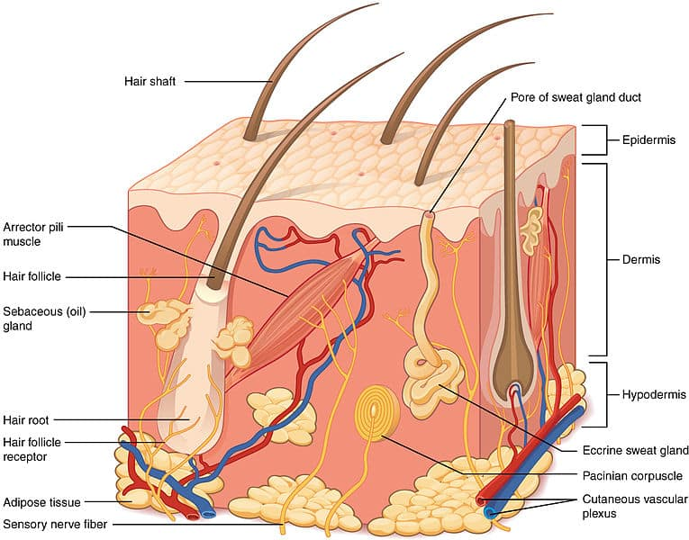
SKIN APPENDAGES
Hair
Sweat glands
Sebaceous glands
Arrector pili muscle
Others:
Blood supply
Nerve supply
Lymphatics

Slide 15
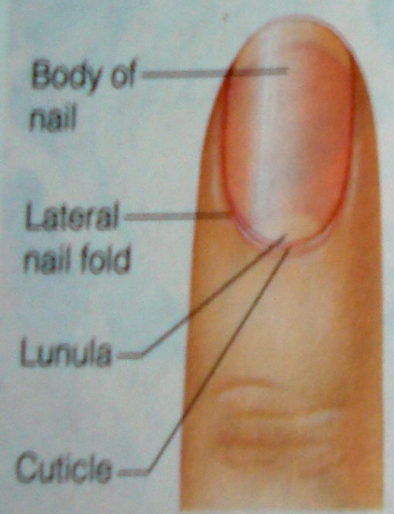
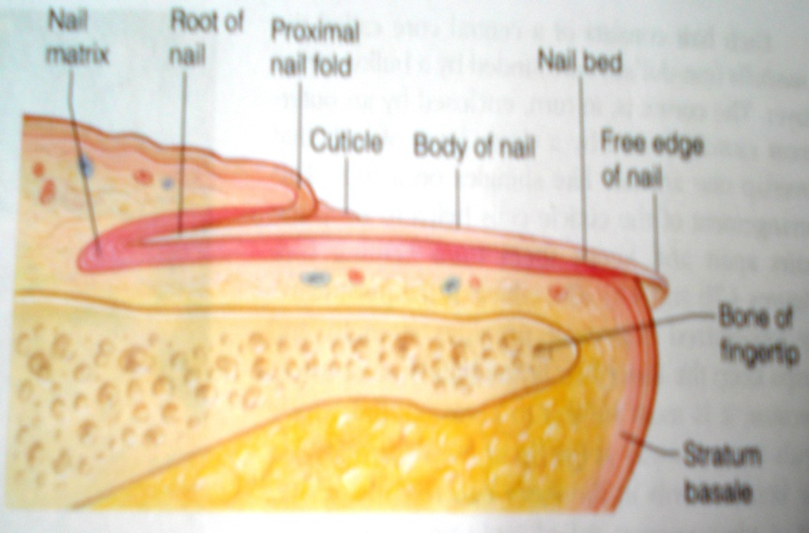
NAILS:
Hardened keratin plates on the dorsal surface of the tips of fingers & toes.
Parts:
a) Root
b) Free border
c) Body
Nail bed: tissue on which the nail rests. Made up of stratum basale & spinosum.

Slide 16
Functions of skin
Presents barrier to physical agents
Protects against mechanical injury
Prevents loss of body fluids
Reduces penetration of UV radiation
Helps regulate body temperature
Acts as a sensory organ(pain, touch, temperature & pressure)
Affords a surface for grip
Plays a role in Vitamin D production
Acts as an outpost for immune surveillance
Cosmetic association
Notes:
It prevents toxins and microorganisms from entering the body.
Shield against external pressure
Protection against UV light
Prevention of desiccation
Immunesurveillance
ThermoregulationInsulation by subcutaneous fat
Regulation of cutaneous blood flow
Eccrine sweat activity(results in cooling)
Muscle activity( includes shivering)
Absorption of ultraviolet radiation from sun for the production of vitamin D

Slide 17
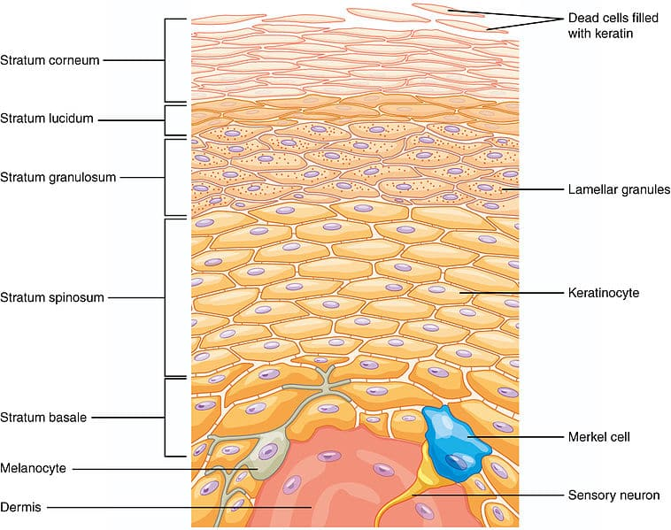

Slide 18


Slide 19
THE SKIN BARRIER

Slide 20
Relevant functional anatomy of the skin
As the first interface between the environment and the immune system, the skin is constantly exposed to both exogenous and endogenous toxic substances and immunogens.
Anatomically, the skin barrier comprises the epidermis which consists primarily of structural and functional proteins, lipids, and mature keratinocytes, with a topmost layer of cornified keratinocytes making up the stratum corneum (SC).
Underlying the epidermis is the dermis, which consists primarily of collagen, elastin fibres, fibroblasts, and nerve endings.

Slide 21
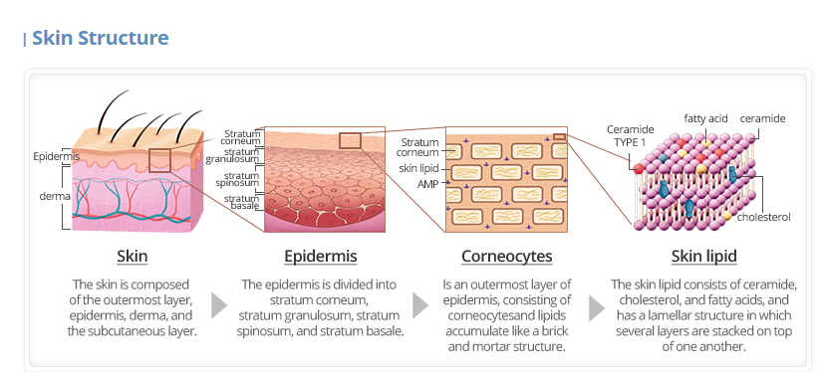

Slide 22
The skin functions as a barrier, protecting underlying tissues from desiccation, infection, mechanical stress and chemical irritation.
The skin barrier is composed of four elements :microbiome; chemical; physical and immune; each working interdependently with the others to maintain overall integrity.
Water from deeper epidermal layers moves upward to hydrate stratum corneum cells and is then lost to evaporation.
Epidermal water content is essential to prevent skin dryness and maintain plasticity.

Slide 23
Stratum corneum is an active membrane, described as a bricks and mortar model, where loss of intercellular lipids, forming the bilayers (e.g., ceramides, cholesterol and fatty acids) will result in water barrier formation damage leading to dry skin.
The structure of the stratum corneum is the pivotal factor in skin water flux, retention and overall moisturizing level.

Slide 24
There are four key processes in stratum corneum formation and functioning:
Corneocyte
Stratum corneum lipid
Natural moisturizing factor and
Desquamation.

Slide 25
Corneocytes are the stratum corneum’s physical barrier, contributing to elasticity when hydrated.
Stratum corneum’s lipid bilayers act as moisture barrier and despite preventing many chemicals entry; they are also means of entry for most topically applied substances.

Slide 26
The natural moisturizing factor(NMF) within corneocytes is a mix of hygroscopic molecules, which maintain and hold corneocytes’ hydration.
Fifty percent of natural moisturizing factors are amino acids originating from keratinocyte protein filaggrin, the remaining are salts, including lactates, urea, and electrolytes. Natural moisturizing factor production is directly related to external humidity.
In desquamation, corneodesmosomes are degraded by water-dependent hydrolytic agent, which work less efficiently in low moisture stratum corneum

Slide 27
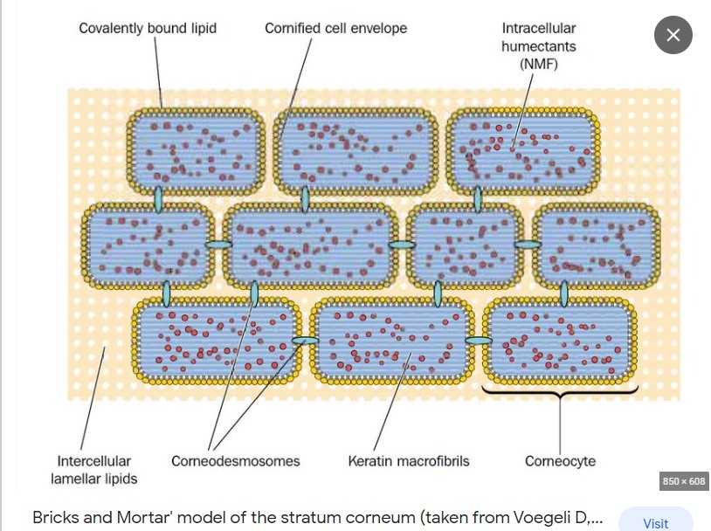

Slide 28
Impairment at any functional level of the skin barrier increases the likelihood of external antigens and pathogens passing through the skin and inducing inflammation, leading to inflammatory skin conditions such as atopic dermatitis
This Impaired function also leads to increasing trans-epidermal water loss associated with various kinds of dermatitis.
Thus, targeted and proactive repair of dysfunctional skin barrier is essential before disease progression.

Slide 29
Skin barrier disruption occurs through various mechanisms, including chemical irritants, bacterial toxins (including S. aureus), scratching, and inflammation.
There is a genetic component to skin barrier disruption that is seen across a spectrum of skin disease e.g. loss-of function mutations in the filaggrin gene impair the structure of the stratum corneum and underlie ichthyosis vulgaris; atopic dermatitis

Slide 30
These mechanisms disrupt the skin barrier, increase penetration of allergens, and cause inflammation, which in turn disrupts the barrier.
This perpetual cycle of barrier disruption and inflammation is well-documented

Slide 31
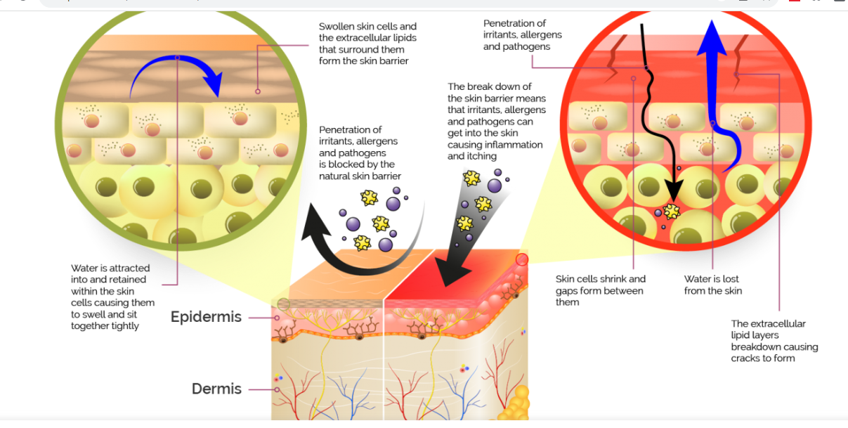

Slide 32
Moisturizer use maintains proper skin barrier function (SBF), combats xerosis, and is a cornerstone of daily skin care.
However, moisturizers become even more critical in the presence of dermatoses in which the epidermal barrier is altered and there is increased transepidermal water loss (TEWL).
As research over the past decade has identified epidermal lipid imbalance and dysbiosis in patients with AD, xerosis, and ichthyosis, the role of moisturizers has advanced.

Slide 33
Routine moisturization is recommended by Dermatologists for maintaining healthy skin and preventing the worsening of skin disease for all individuals, with or without preexisting dermatoses

Slide 35

SKIN DIVERSITY AND FITZPATRICK SCALE

Slide 36
Human skin diversity is a vast, multifaceted topic encompassing variations in pigmentation, texture, microbiome, and vulnerability to conditions.
It requires tailored approaches to skincare.
Example: Different Fitzpatrick skin types react uniquely to sun exposure, aging, and medical treatments.

Slide 37
Understanding the scope of skin diversity involves looking at several biological and clinical factors:
Pigmentation: Skin colour is determined by melanin concentration, which dictates sun sensitivity.
Lighter skin types burn easily and require higher SPF, whereas darker skin types naturally produce more melanin but are more prone to hyperpigmentation

Slide 38
Physiological Variations: Differences in lipid barrier function, stratum corneum thickness, and ceramide levels affect how different skins retain moisture and respond to external irritants.
Microbiome: The outer layer of the skin is home to a rich diversity of commensal bacteria (like Proteobacteria) that influence overall health and interact with different immune systems
Medical Presentations: Certain conditions, such as atopic dermatitis or lichen planus, present differently in individuals with diverse skin tones.
….Choice of procedures : e.g Lasers, depth of peels

Slide 39
The three principal human skin colors: black, brown, and white, is due to variations in the type, amount and distribution of melanin in the skin.
These basic skin colours are determined by
Constitutive melanin pigmentation: this is produced as a result of baseline activity of tyrosinase and it is genetically determined
Inducible melanin pigmentation: this is a stimulated (facultative) melanin production due to exposure to ultraviolet radiation (UVR) or pituitary hormones e.g. MSH, ACTH

Slide 40
The combination of the constitutive and inducible melanin pigmentation determines what is called the skin phototype (SPT)
The Fitzpatrick Scale was created in 1975 by Dr. Thomas B. Fitzpatrick

Slide 41
The Fitzpatrick Scale is a numerical classification system that categorises human skin into six different types based on its reaction to sun exposure.
It takes into account factors such as skin colour, sensitivity to the sun, and susceptibility to burning or tanning.

Slide 42
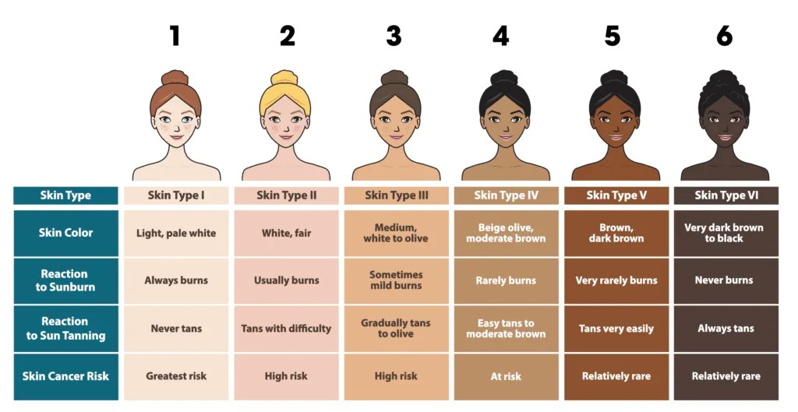

Slide 43
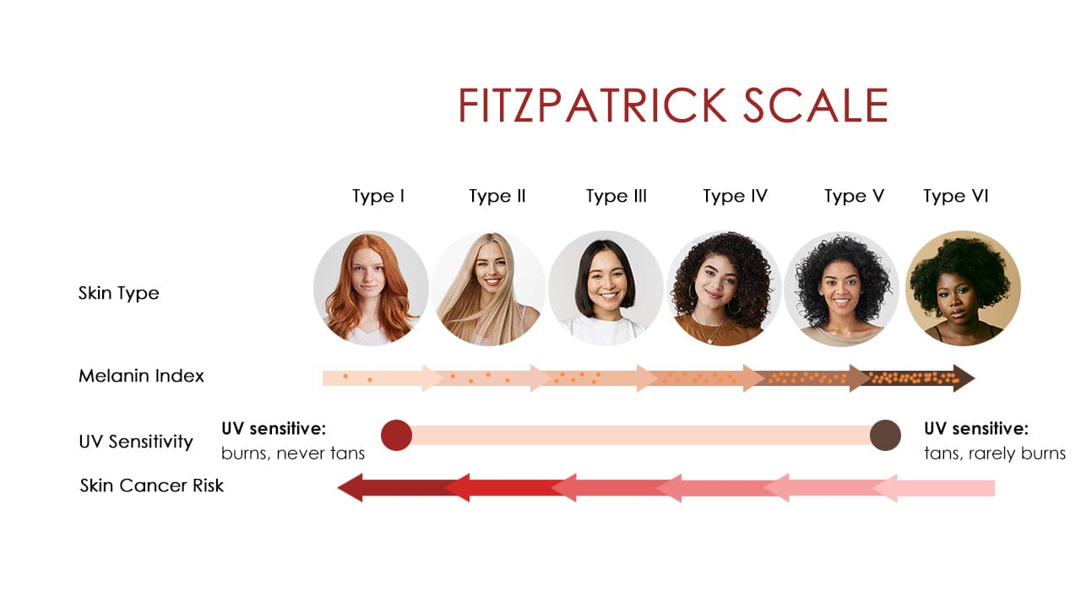

Slide 44
NOTE: The SPT is not determined strictly by ethnicity.
Hence, African "black" ethnic persons can be SPT Ill and an East Indian Caucasian can be SPT IV or even V.

Slide 46
Inflammation, Histamine & Immune Response

Slide 47
The Inflammatory Response
Inflammation is the body's biological response to harmful stimuli, such as irritants, pathogens, and damaged cells or
Inflammation is the immune system's first-line of defence against injury, infection, or allergens.

Slide 48
It follows a predictable cascade:
Trigger (pathogen, allergen, trauma) → tissue damage
Mast cells release preformed mediators (histamine, heparin)
Vasodilation → increased blood flow → redness & warmth
Increased vascular permeability → fluid leaks into tissue → swelling
Chemotaxis → neutrophils, then macrophages recruited to site
Resolution or chronicity

Slide 49
Histamine
Receptor | Effect | Dermatological relevance
H1 | Vasodilation, itch (pruritus), bronchoconstriction | Urticaria, atopic dermatitis, allergic reactions
Released primarily from mast cells and basophils, histamine acts on:

Slide 50
Immune Response: Innate vs Adaptive
Innate (fast, non-specific) — relevant to acute skin reactions: bacterial infections, contact irritants.
Adaptive (slow, specific, memory-forming) — relevant to:
Type I hypersensitivity (IgE-mediated): urticaria, angioedema, anaphylaxis
Type IV hypersensitivity (T-cell mediated, delayed): allergic contact dermatitis (e.g. nickel, poison ivy) — no antibodies involved

Slide 51
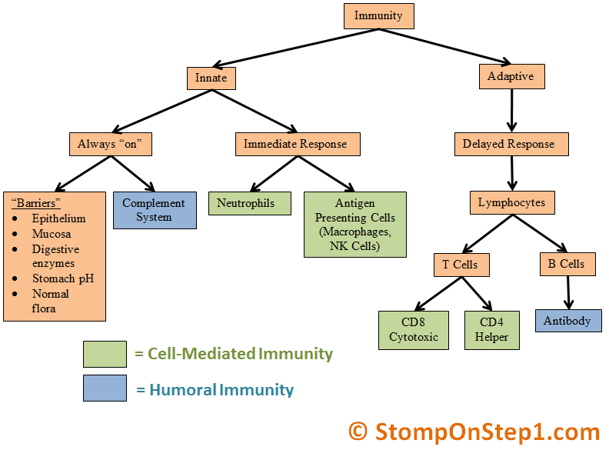

Slide 52
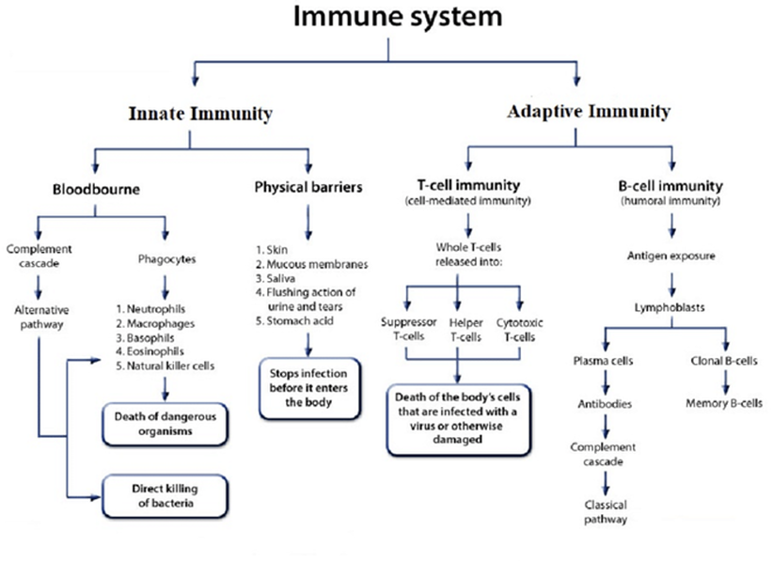

Slide 53
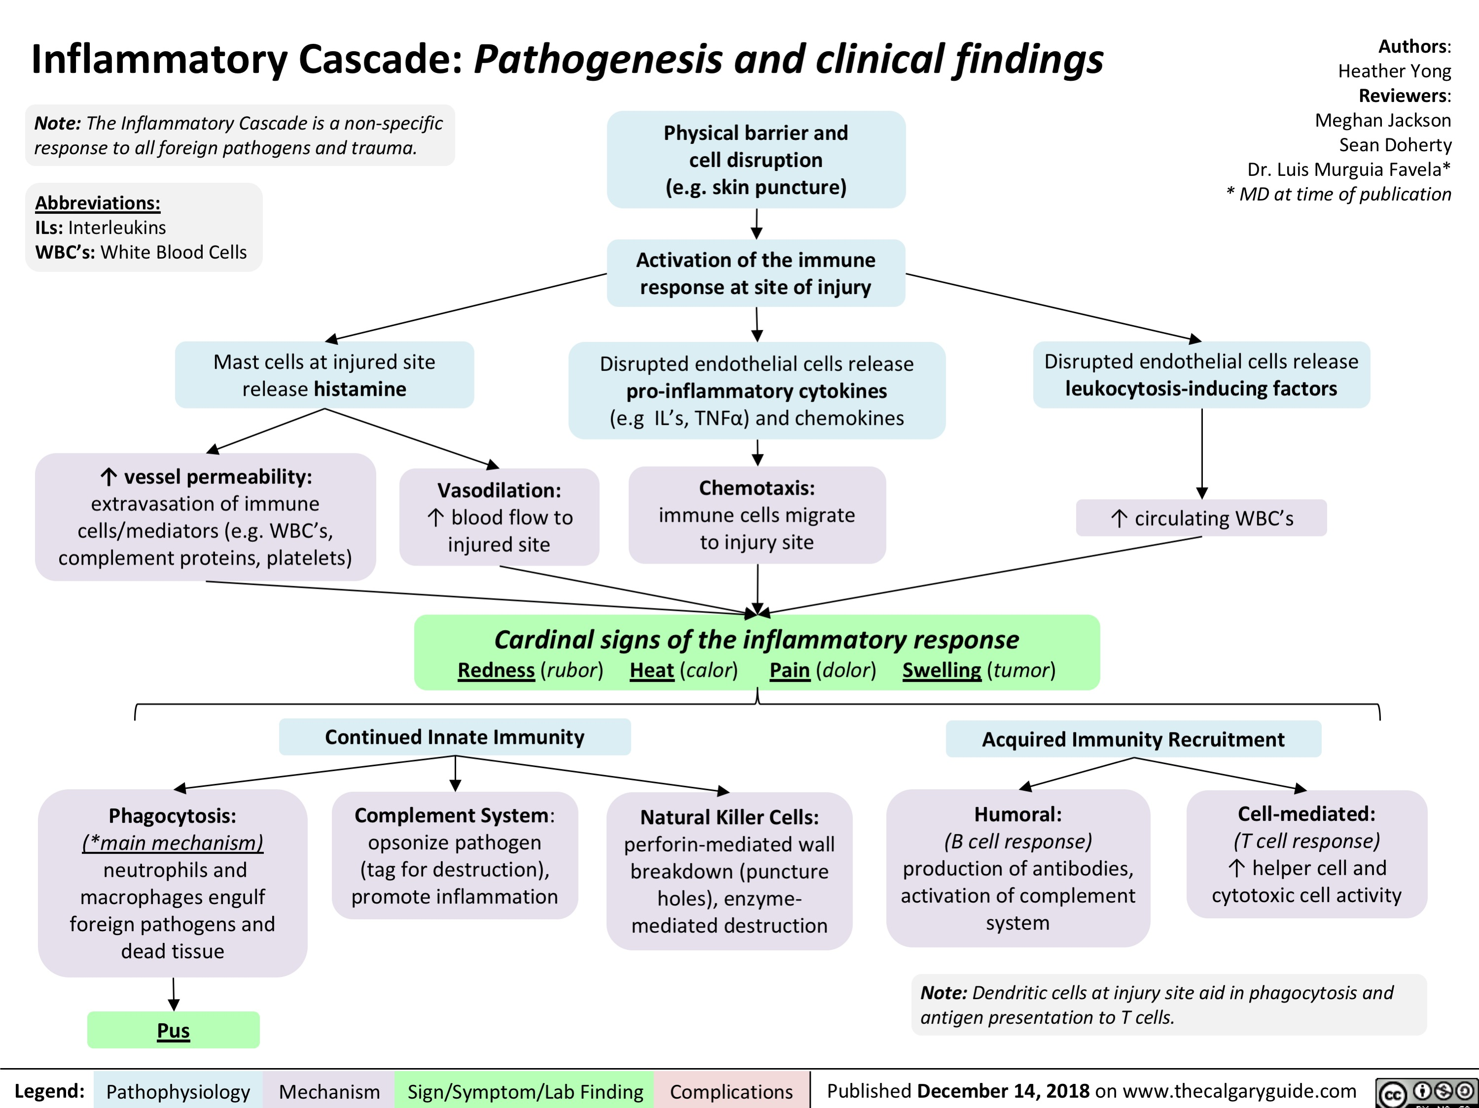

Slide 54
Condition | Mechanism | Relevance
Urticaria (hives) | Mast cell degranulation → histamine | Antihistamines first-line; watch for angioedema
Atopic dermatitis (eczema) | Th2-skewed immune response; barrier dysfunction | Chronic; flare triggers, emollient education
Allergic contact dermatitis | Type IV (delayed, T-cell) | Symptom onset 48–72 hrs after exposure
Psoriasis | Th17/Th1 driven chronic inflammation | Not allergic; autoimmune; systemic implications
Anaphylaxis | Massive IgE/mast cell response | Emergency: epinephrine, airway management

Slide 55
Inflammation results from various skin insults such as acne, eczema, trauma, or dermatologic procedures
These triggers the release of inflammatory cytokines, prostaglandins, and reactive oxygen species.
These mediators stimulate melanocytes to produce excess melanin, which is then transferred to surrounding keratinocytes in the epidermis and, in some cases, leaks into the dermis and is engulfed by macrophages.

Slide 56
End result – post-inflammatory hyperpigmentation
The severity and persistence of postinflammatory hyperpigmentation depend on the degree of inflammation and the depth of melanin deposition.
Individuals with darker skin types are more susceptible due to their higher baseline melanin production and more reactive melanocytes

Slide 57
Clinical Pearls
Pruritus = histamine + neuropeptides — scratching worsens inflammation (itch-scratch cycle)
Antihistamines work best for Type I reactions; they do nothing for Type IV (contact dermatitis)
Topical/systemic corticosteroids suppress the broader inflammatory cascade
Chronic inflammation → skin remodeling → lichenification (skin thickening)

Slide 58
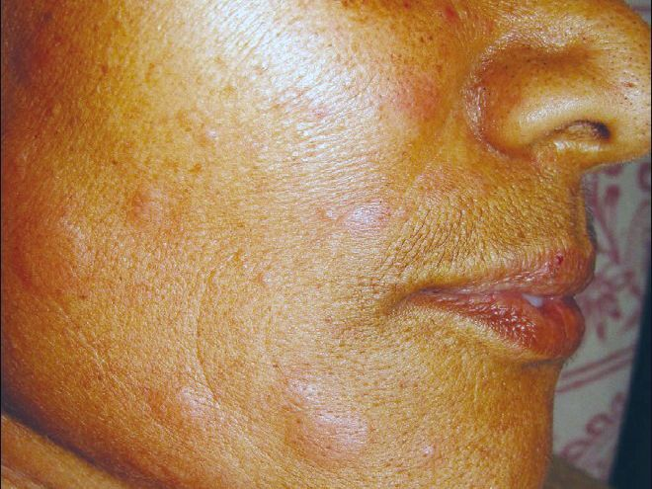
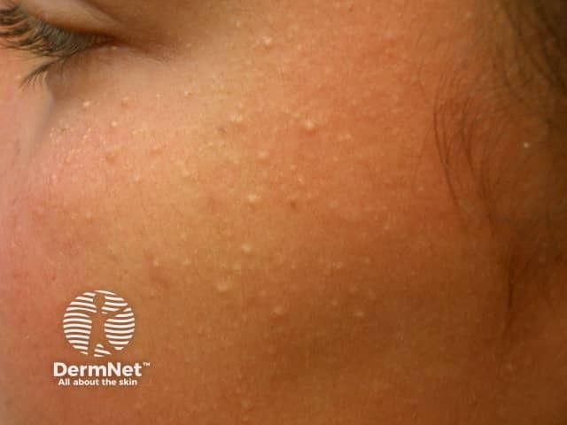

Slide 59
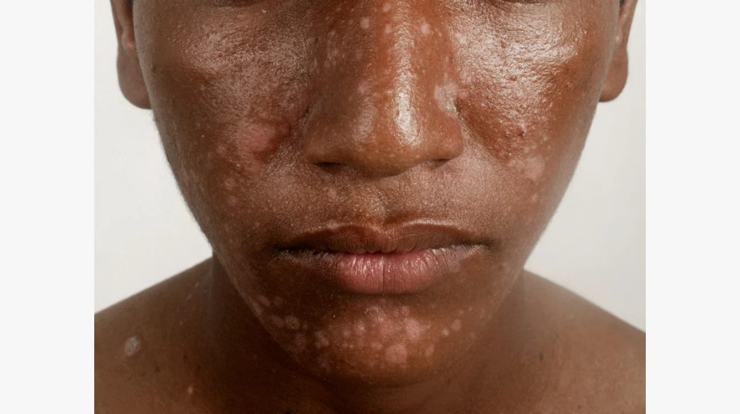
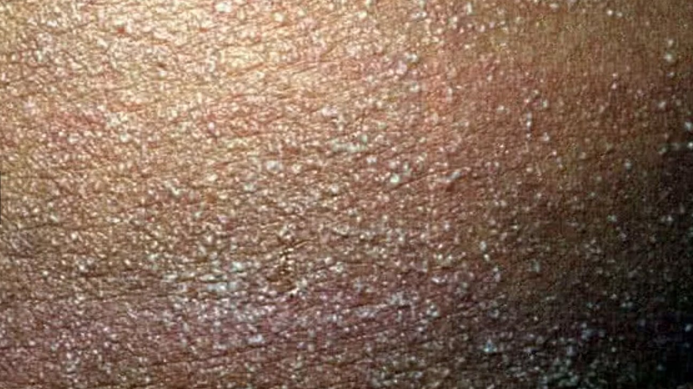

Slide 60
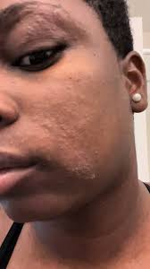
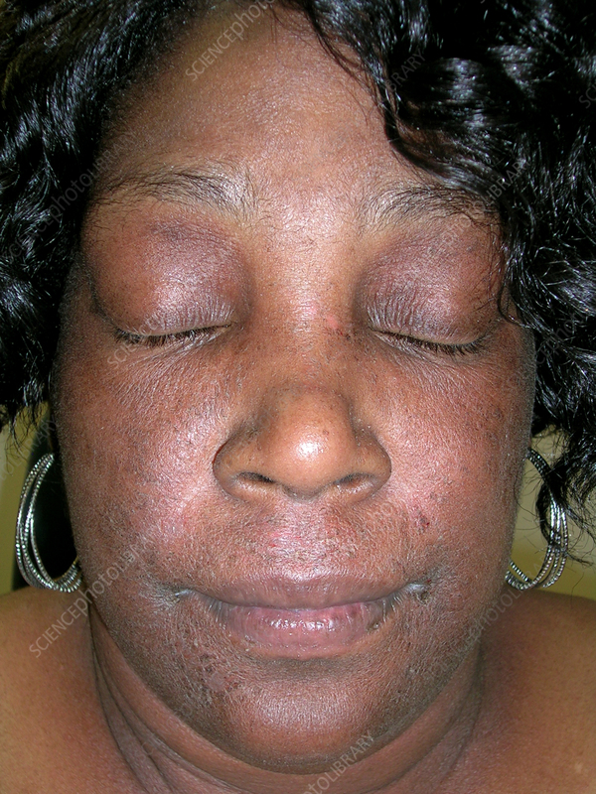

Slide 62
PIGMENTATION

Slide 63
Components of normal skin colouration
Skin colour results from multiple chromophores.
Endogenous epidermal chromophores include DNA, urocanic acid, amino acids, and melanin.
These produce distinct hues: yellow (carotenoids), red (oxygenated haemoglobin), and blue (reduced haemoglobin), and melanin (brown-black/yellow-red)
Genetics (constitutive)

Slide 64
Melanocytes are melanin-producing neural crest-derived cells located in the stratum basale of the skin's epidermis, the uvea of the eye, the inner ear, vaginal epithelium, and meninges
The pigment melanin produced by melanocytes, is the main determinant of human skin pigmentation

Slide 65
In humans, melanin exists as eumelanin (black brown), pheomelanin (yellow-red) , produced in the pathway of melanogenesis and neuromelanin.
Melanin synthesis requires the copper-containing enzyme tyrosinase which acts on tyrosine as its initial substrate

Slide 66
Structure and function of melanocytes
Melanocytes are melanin-producing cells found in the epidermis and hair follicles
They reside in the stratum basalis and maintain this location throughout life.
Approximately every 10th cell in the basal layer is a melanocyte
They have multiple, regularly spaced dendrites which come into contact with keratinocytes as far away as the mid stratum spinosum

Slide 67
They contain a unique intracytoplasmic organelle, the melanosome, which is the site of melanin biosynthesis
Synthesised melanin in melanosomes gets transferred to surrounding keratinocytes

Slide 68
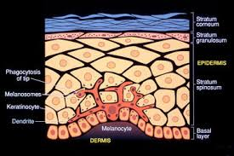
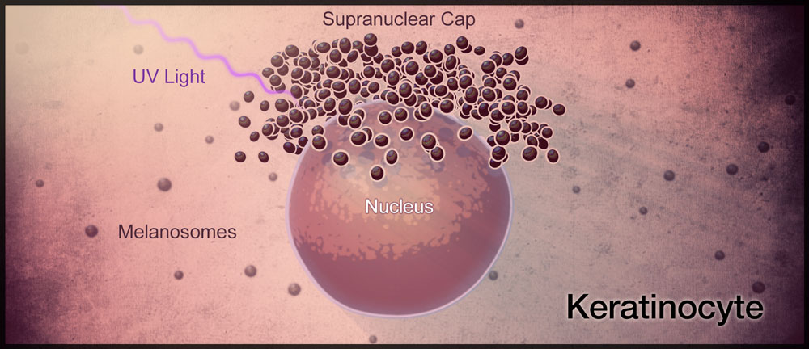
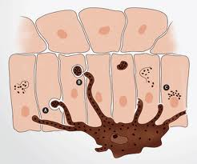
Melanocyte in the Stratum Basale of Epidermis
Structure of melanocytes, melanosomes and melanin epidermal unit

Slide 69
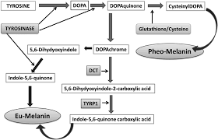
THE MELANOCYTE AND MASON RAPER PATHWAY OF MELANIN SYNTHESIS

Slide 70
Melanogenic enzymes
Melanin synthetic pathway and the involvement of melanogenic enzymes
Initial melanin synthesis is catalyzed by tyrosinase and is then divided into eumelanogenesis or pheomelanogenesis.
The melanogenic enzymes L-3,4-dihydroxyphenylalanine (DOPA) chrome tautomerase (DCT) and tyrosinase-related protein 1 (TYRP1), are involved in eumelanogenesis
No specific enzymes have been found that are involved in pheomelanogenesis .

Slide 71
NOTE: Racial differences in melanocyte morphology are apparent but the population density of melanocytes in a particular skin site remains relatively constant in all races.

Slide 72
Even the most severe form of OCA (OCA type 1A), have a normal complement of epidermal melanocytes
Cutaneous pigmentation does not depend on melanocyte number, but rather on melanogenic activity within the melanocyte.
The melanogenic activity is defined by:
  the proportion of mature melanosomes, and/or
  their transfer and distribution within the keratinocytes

Slide 73
Function of melanocytes
Its function varies from camouflage to the quenching of oxidative free radicals generated via exposure to UV radiation (UVR).
They play a role in the development of normal hearing in the inner ear (stria vascularis)

Slide 74
The activities of the melanocytes are influenced by autocrine, paracrine, and endocrine factors, and by ultraviolet radiation
UV radiation acts directly (by stimulating melanocyte dendricity and melanin production), and by increasing the synthesis and secretion of most keratinocyte-derived factors

Slide 75
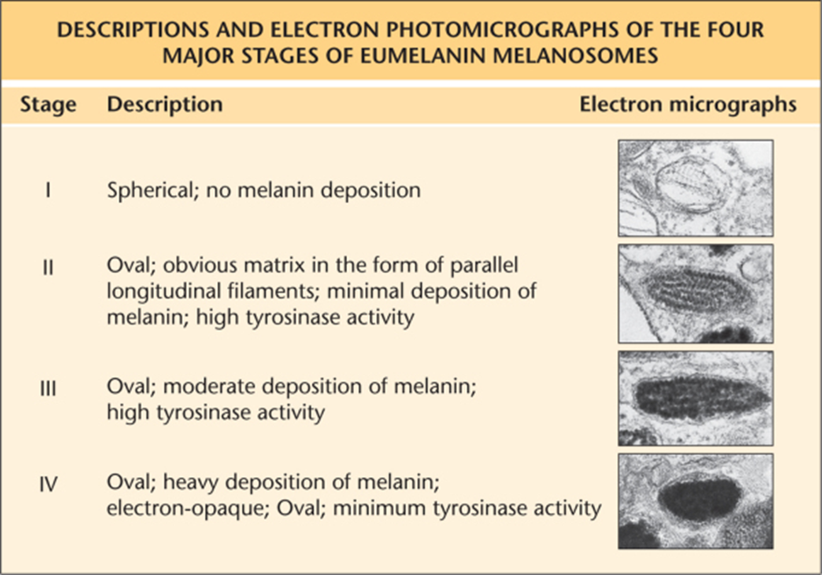
4 stages of Eumelanin melanosomes formation (Melanization)
Stages | Description
I | Spherical No melanin deposition
II | Oval Obvious matrix (parallel longitudinal filament) Minimal deposition of melanin High tyrosinase activity
III | Oval Moderate deposition of melanin High tyrosinase activity
IV | Oval Heavy deposition of melanin (electron-opaque) Minimum tyrosinase activity

Slide 76
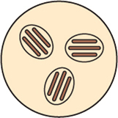
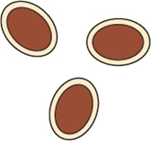
DIFFERENCES BETWEEN MELANOSOMES IN LIGHTLY PIGMENTED AND DARKLY PIGMENTED SKIN
 | Lightly pigmented skin | Darkly pigmented skin
Melanization | Stages II, III | Stage IV
Size (diameter) | 0.3–0.5 mm | 0.5–0.8 mm
Number per cell | <20 | >200
Distribution of melanosomes within the lysosomes of keratinocytes | Groups of 2–10 | Single
Melanin granules | Degraded at mid stratum spinosum | Still found in stratum corneum (slow degradation)

Slide 77
Exposure to UVR
Single exposure: increase in the size of melanocytes
          Increase in tyrosinase activity
Repeated exposures: increase in the number of active melanocytes.
          Increase in the number of stage IV melanosomes transferred to keratinocytes
Chronic exposure: Increase in the density of melanocytes
          Chronically sun-exposed sites (e.g. the upper outer arm) are compared with non-sun-exposed sites (e.g. the upper inner arm), the density of melanocytes is up to two times greater in sun-exposed sites

Slide 78
Disorders of pigmentation
This typically indicates an increased amount of melanin, leading to a darker skin colour (hyperpigmentation), or reduced/absent melanin leading to lighter skin colour (hypopigmentation/depigmentation)
Abnormal skin pigmentation is one of the most common reasons for dermatology consultation.
It presents as abnormally white or dark areas of the skin with or without clear borders
This may be unsightly in individuals with darker skin types
It is associated with significant psychosocial disturbances and may lead to anxiety or depression.

Slide 79
Types of pigmentary disorders
Hyperpigmentary disorders
Hypopigmentary or depigmentary disorders
Other excess body pigments
  Carotenoids
  Bilirubinemia
  Haemachromatosis
  Haemosiderosis
  Argyrosis silver dust

Slide 80
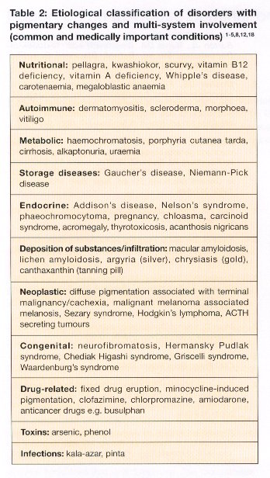

Slide 81
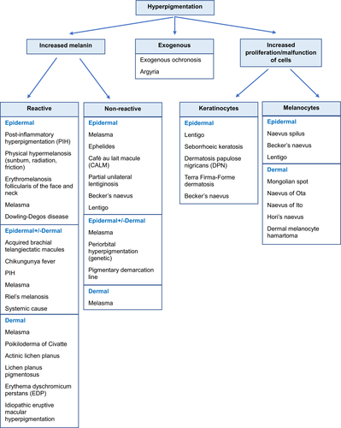

Slide 82
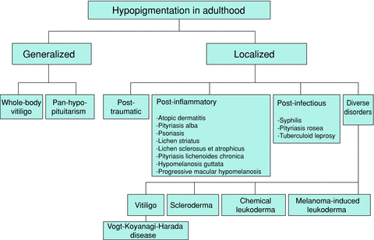

Slide 83
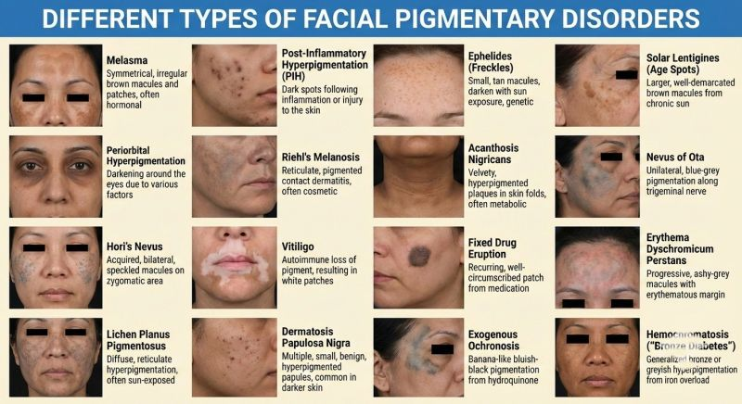

Slide 85
ACNE
Acne types

Slide 86
Introduction
Acne vulgaris is a chronic inflammatory disorder of the pilosebaceous unit
It is primarily a disorder of adolescence. However, its many variants can affect all age groups.
It is multifactorial
It is clinically characterized by comedones, papules, pustules, cysts and scarring, with the lesions commonly distributed on the sebum-rich areas

Slide 87
Acne cannot be stopped from occurring or cured , but it can be treated quiet successfully.
Acne can profoundly affect the self-esteem of the affected individuals

Slide 88
Risk factors
Genetic predisposition : positive family history of severe acne
TNF alpha , IL – 1 alpha, CYP1A1 genes , Alpert sydrome , XYY syndrome (rare).
Hormones ; androgens e.g testosterone, dihydrotestosterone , DHEA, GH, IGF – 1, POS, CAH, Pregnancy, testosterone replacement therapy , steriods.
Infection ; C. acne, parasitic mite Demodex
Diet ; high glycemic load and milk
Acnegenic mineral oil e.g rarely dioxin,
Drugs e.g Lithium, hydantoin, isoniazid, glucocorticoids, oral contraceptives, iodides, bromides and androgens, and danazol Others.
Emotional stress (exacerbation).
Occlusion and pressure on the skin e.g leaning the face on the hands (acne mechanica).

Slide 89
Pathogenesis
The key pathogenetic mechanisms are
Abnormal keratinization: Follicular plugging with prevention of sebum drainage (comedones)
Sebum overproduction: due to increased androgen receptor sensitivity at the sebocyte levels (the serum androgen levels remain normal quantitatively and qualitatively)
Microbial colonization: P. acnes produces lipase (converts lipids to free fatty acids) and other proinflammatory mediators (IL-1, TNF-a)
Inflammation

Slide 90
Distended follicle walls break
Sebum, lipid, fatty acids, keratin, and bacteria enter the dermis, provoking an inflammatory and foreign-body response.
Intense inflammation leads to scarring

Slide 91
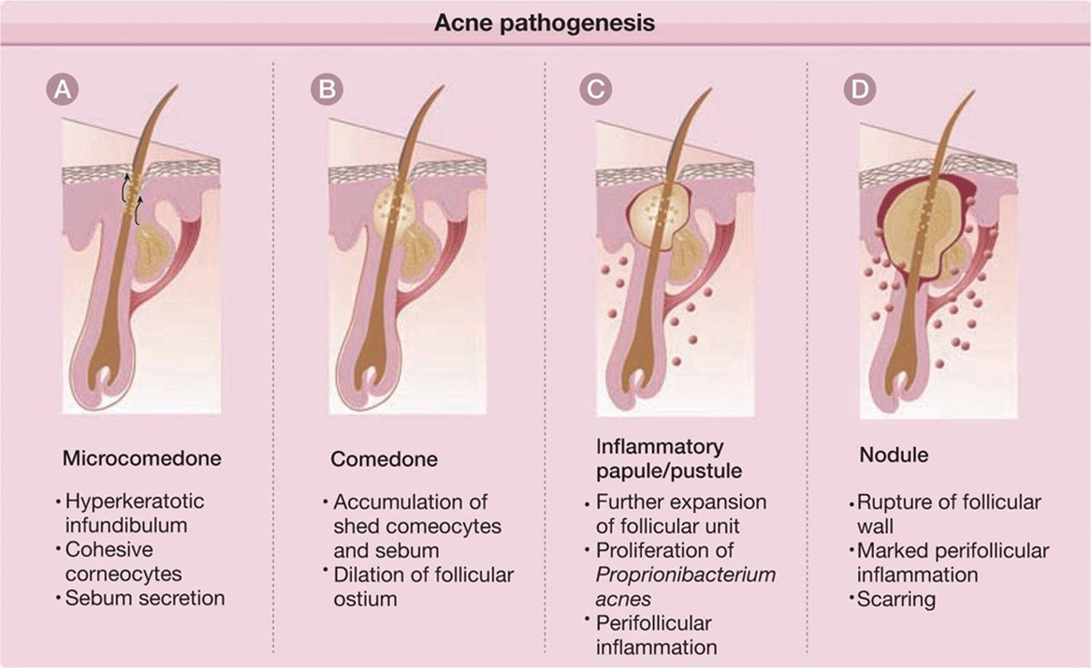

Slide 92
Classification
Primary lesions (Non-inflammatory)
Inflammatory lesions

Slide 93
Clinical features
The clinical presentation varies significantly from mild comedonal acne to fulminant systemic disease.
Primary lesions:
Comedonal acne: open (blackheads) and closed (whiteheads) comedones
  Comedones: are keratin plugs formed within follicular ostia (frequently associated with surrounding erythema and pustule formation).

Slide 94
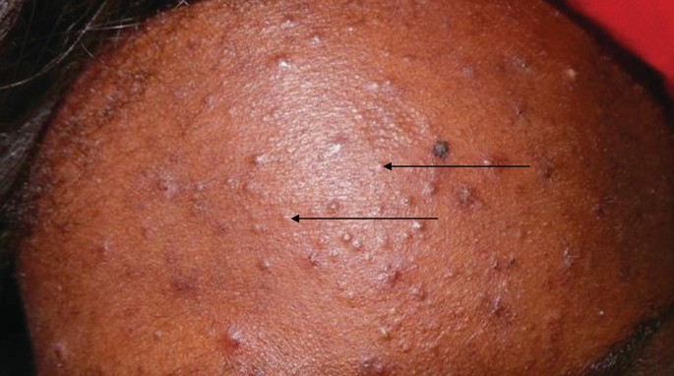
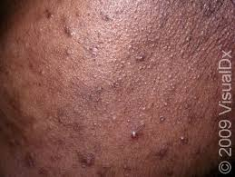
Closed comedones (white heads): associated with small ostia
Open comedones (black heads): associated with large ostia

Slide 95
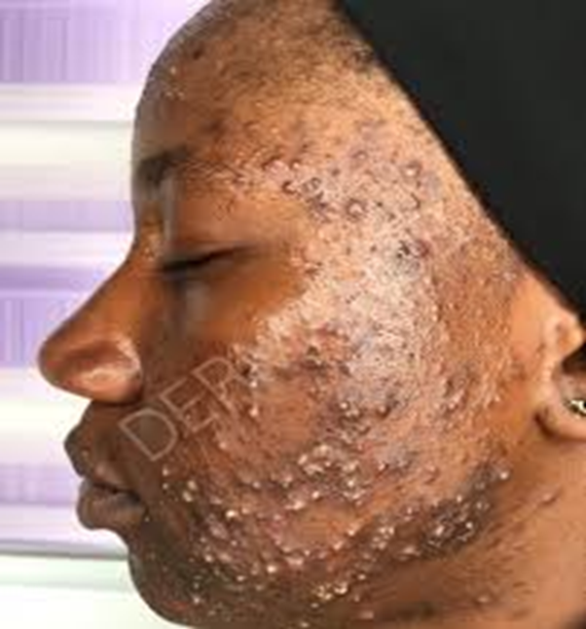
Inflammatory lesions:
Papulopustular acne: Papules and papulopustules (papule topped by a pustule)

Slide 96
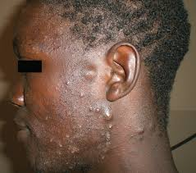
Nodulocystic: nodules and cysts
  Soft nodules: result from repeated follicular ruptures and re-encapsulation with inflammation, postulation/abscess formation (cysts), crusting, foreign-body reaction, and scarring.
  Linear mounds: formed from a coalition of round, isolated single nodules, and cysts with interconnecting channels (sinus tracts)

Slide 97
Sinuses: draining epithelial-lined tracts (seen in nodular acne).
Scars: depressed atrophic (often pitted) or hypertrophic (sometimes keloidal).
Seborrhea involving the face and scalp are often present and may be severe
Pain: present in inflammatory lesions

Slide 98
Special forms of acne
Neonatal acne: affect the nose and cheeks of newborns and infants.
  Related to glandular development
  Transient and self-healing (self limiting).
Acne excoriee: young women
  Associated with extensive excoriations and scarring
  Results from emotional and psychological problems (obsessive compulsive disorder)

Slide 99
Acne mechanica: acne flares occur on the cheeks, chin, and forehead.
  Due to leaning the face or forehead on the hands.
  Also from the pressure of sports gear such as helmets.
Acne conglobate: severe nodulocystic acne
  Coalescing nodules and cysts, abscesses, and ulceration
  More involvement of the trunk than the face (also on the buttocks)
  Rarely seen in XYY genotype or polycystic ovary syndrome (PCOS)
  Spontaneous remission rare.

Slide 100
Acne fulminans: occurs primarily in teenage boys.
  Acute onset of severe nodulocystic acne with suppuration, friable plaques, hemorrhagic crusts, ulcerations, and significant scarring.
  Affects the face, neck, chest, back and arms
  Systemic features: malaise, fatigue, fever, generalized arthralgias,
  Leukocytosis, and elevated ESR.
Tropical acne: present with severe folliculitis, inflammatory nodules, and draining cysts
  Seen in tropical climates
  Affect the trunk and buttocks
  Secondary infection with Staphylococcus aureus.

Slide 101
Occupational acne: caused by exposure to tar derivatives, cutting oils, chlorinated hydrocarbons
  Not restricted to predilection sites, and can appear on other (covered) body sites like arms, legs, or buttocks
Chloracne: exposure to chlorinated aromatic hydrocarbons in electrical conductors, insecticides, and herbicides.
  It can be very severe following industrial accidents or intended poisoning (e.g., dioxin).
Acne cosmetic: Caused by comedogenic cosmetics.
  Pomade acne: from application of pomade to hair, usually in Africans.
  Occurs on the forehead

Slide 103
WOUND HEALING

Slide 104
Wound healing is a complex biological process where the body restores the integrity of damaged skin or tissues.
It involves a precise sequence of cellular, molecular, and chemical events to stop bleeding, clear away damaged tissue, and generate new skin or scar tissue

Slide 105
Wound healing serves as the biological bedrock for both medical repair and aesthetic enhancements.
Aesthetic procedures utilise controlled, localised injury to harness the body's natural healing cascades, specifically collagen production and tissue remodelling, to reduce signs of ageing and improve overall skin quality

Slide 106
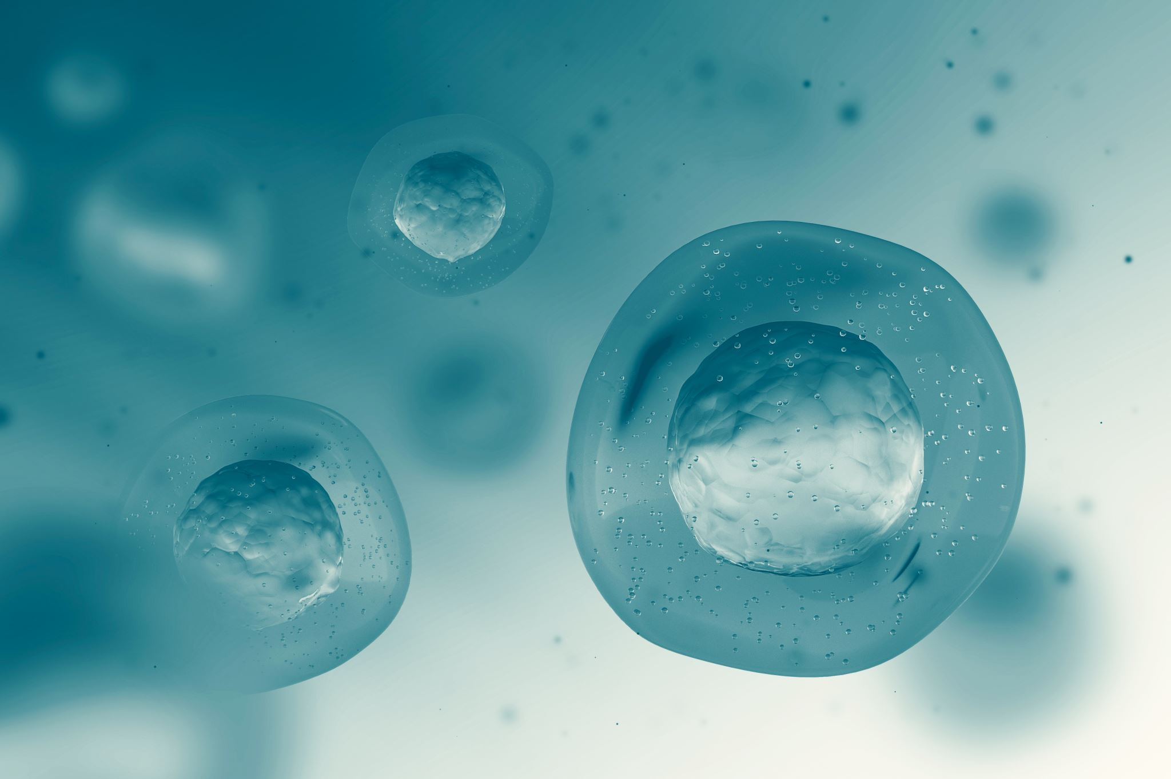
Wound healing is a dynamic, tightly regulated process characterised by four overlapping phases
Hemostasis: Immediately following an injury, platelets aggregate at the site to form a clot, releasing growth factors (e.g. TGF-beta, PDGF) to jumpstart the repair process
Inflammation: Immune cells (neutrophils and macrophages) clear the wound of debris and bacteria.
NOTE: While crucial, prolonged inflammation can lead to delayed healing and undesirable scarring

Slide 107
Proliferation: Fibroblasts migrate to the wound bed to synthesize new extracellular matrix (ECM) and collagen. Simultaneously, new blood vessels (angiogenesis) form to supply oxygen, and the skin's surface re-epithelializes.
Tissue Remodelling: This final phase can last from months to years. The fragile Type III collagen initially deposited is degraded and replaced by stronger, highly organized Type I collagen

Slide 108
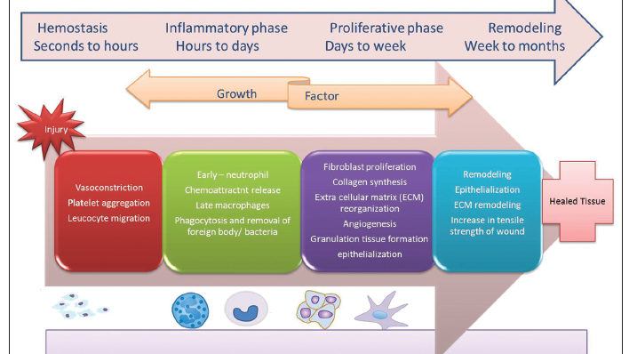

Slide 109
RELEVANCE
In aesthetic dermatology we turn the principles of wound healing into a therapeutic tool.
Because the ultimate goal of healing is to fill tissue defects and stimulate support structures, aesthetic procedures intentionally trigger the healing cascade.

Slide 110
Collagen Induction Therapy (Microneedling & RF Microneedling):
Needles create controlled micro-injuries in the dermis. This deliberately triggers the proliferative and remodelling phases, forcing the skin to produce fresh, youthful collagen which minimizes wrinkles and acne scars.

Slide 111
Energy-Based Devices (Lasers & IPL):
Fractional lasers (e.g., fractional C02 cause microscopic thermal injuries. The body responds by removing damaged cells and laying down tightened, rejuvenated skin tissue during the remodelling phase.

Slide 112
Biostimulatory Injectables (e.g., PLLA, CaHA): Injectables like poly-L-lactic acid act by instigating a low-grade, subclinical inflammatory response. This tricks the body's fibroblasts into generating new collagen, adding volume and structural support.

Slide 113
Modulating Healing for Optimal Cosmetic Outcomes
Aesthetic dermatologists constantly balance inducing an injury and ensuring the healing process results in minimal visible scarring or downtime.
Platelet-Rich Plasma (PRP): Topically applied or injected, PRP utilizes the high concentration of growth factors from a patient's own platelets to accelerate the proliferative and remodelling phases, thereby reducing downtime and improving overall skin rejuvenation

Slide 114
Optimized Wound Bed Preparation (TIME Framework): To ensure optimal tissue regeneration, dermatologists focus on Tissue management, Infection control, Moisture imbalance, and Epithelial advancement.
Topical Support: Targeted post-procedure skincare (e.g., utilizing peptides, growth factors, or hyaluronic acid complexes) is critical to support the skin barrier, manage inflammation, and accelerate re-epithelialization.

Slide 115
Mastering wound healing allows dermatologists and medical aestheticians to trigger regeneration while actively mitigating the risks of scarring, hyperpigmentation, or delayed healing, ultimately leading to safer, more effective cosmetic outcomes

Slide 117
CONTRAINDICATIONS

Slide 118
In aesthetic medicine, a "contraindication" is any condition, circumstance, or factor that makes a particular treatment inadvisable or potentially dangerous

Slide 119
Why Contraindications Matter.
Aesthetic treatments, while generally very safe, involve real medical interventions utilising needles, energy devices, and pharmaceutical products which interact with the body’s biological systems.
When certain medical conditions, medications, or circumstances are present, these interactions can produce adverse outcomes ranging from suboptimal results to serious complications.

Slide 120
Responsible practitioners screen for contraindications not to refuse treatment unnecessarily but to ensure that every treatment delivered is as safe and effective as possible.
On occasion, this means delaying treatment until a temporary contraindication resolves. Other times, it means selecting an alternative treatment that is safe for the individual patient.

Slide 121
Absolute vs Relative Contraindications
Absolute Contraindications
Relative Contraindications
These are conditions where a treatment must NOT be performed under any circumstances:
The risk of harm clearly outweighs any potential benefit
No modification of technique or parameters can make the treatment safe
Proceeding would be medically negligent
These are conditions where treatment may still be possible but requires:
Modified technique, dosage, or parameters
Additional precautions or monitoring
Informed consent with specific risk discussion
Medical clearance from the patient’s GP or specialist
Careful risk-benefit assessment on a case-by-case basis

Slide 122
Common Contraindications by Treatment Category

Slide 123
Chemical Peels
Absolute Contraindications
Active skin infection (herpes, impetigo, fungal infections, warts) in the treatment area
Open wounds or compromised skin barrier
Current isotretinoin use (medium to deep peels) or within 6 months of completing a course
Known allergy to peel components
Pregnancy

Slide 124
Chemical peels
Relative Contraindications
Darker skin types: Higher risk of post-inflammatory hyperpigmentation. Superficial peels with appropriate agents (mandelic, lactic) may be used safely
Active eczema or dermatitis
Recent sunburn or significant tan
Use of topical retinoids (pause 5-7 days before treatment for some peels)

Slide 125
Microneedling
Absolute Contraindications
Active acne, rosacea, or eczema in the treatment area
Active infection (bacterial, viral, fungal) at the treatment site
Blood clotting disorders or current anticoagulant therapy (absolute for deep needling; relative for superficial)
Current isotretinoin use
Keloidal scarring tendency
Active skin cancer in the treatment area

Slide 126

Laser and IPL Treatments
Absolute Contraindications
Current use of isotretinoin: Impairs wound healing and increases scarring risk. A minimum 6-month washout period is required after completing the course
Active skin infection in the treatment area: Bacterial, viral, or fungal infections can be worsened or spread by laser energy
Pregnancy: Laser safety during pregnancy has not been established
Photosensitising medications: Certain antibiotics (tetracyclines, fluoroquinolones), antifungals, and other medications increase the skin’s sensitivity to light, dramatically increasing burn risk
Recent tan or sunburn: Increased melanin in tanned skin absorbs more laser energy, significantly increasing burn and pigmentation risk

Slide 127
Relative Contraindications
Darker skin types (Fitzpatrick IV-VI): Some laser and IPL devices carry higher risks for darker skin. Specific wavelengths (Nd: YAG) and adapted parameters can often be used safely
History of keloid or hypertrophic scarring: Ablative laser treatments may trigger abnormal scarring. Non-ablative treatments may be possible with careful parameters
History of herpes simplex: Laser treatment can reactivate cold sores. Prophylactic antiviral medication is indicated
Epilepsy: Pulsed light can theoretically trigger seizures in photosensitive epilepsy (very rare but documented)
Active dermatological conditions: Eczema, psoriasis, and rosacea in active flare may be worsened by laser treatment

Slide 128
Injectable Treatments (Fillers, Anti-Wrinkle Injections, Biostimulators
Absolute Contraindications
Pregnancy and breastfeeding: Injectable products have not been tested for safety during pregnancy. While harm is not proven, the absence of safety data makes treatment inadvisable
Known allergy to product components: True allergy to hyaluronic acid (extremely rare), botulinum toxin, or product excipients
Active infection at treatment site: Injecting through infected tissue can spread the infection and create serious complications including abscess formation
Active autoimmune disease affecting treatment area: Conditions like scleroderma or dermatomyositis in active flare can cause unpredictable healing responses
Neuromuscular disorders (for botulinum toxin): Conditions like myasthenia gravis, Lambert-Eaton syndrome, or motor neurone disease — botulinum toxin can worsen neuromuscular transmission

Slide 129

Relative Contraindications
Anticoagulant therapy: Warfarin, DOACs, or antiplatelet medications increase bruising risk. Treatment is possible but patients should be informed of increased bruising probability
History of cold sores (for perioral treatments): Injectable treatments around the mouth can trigger herpes simplex reactivation. Prophylactic antiviral medication (aciclovir/valaciclovir) is recommended before treatment
Dental procedures: Avoiding fillers for 2 weeks before and after dental work to reduce infection risk and allow accurate assessment
Recent vaccination: A 2-week gap between vaccination and injectable treatments is generally recommended to avoid confounding immune responses
Previous permanent fillers: The presence of non-absorbable fillers (silicone, PMMA) increases the risk of complications with subsequent HA filler injections

Slide 130

Medication Interactions
Many common medications can interact with aesthetic treatments increasing the risk of bruising with all injectable and needling treatments:
Aspirin, ibuprofen, naproxen
Warfarin, apixaban, rivaroxaban, dabigatran
Clopidogrel
Fish oil, vitamin E (high dose), ginkgo biloba, garlic supplements, evening primrose oil
Immunosuppressive Medications e.g. methotrexate, azathioprine, ciclosporin, and biological agents (adalimumab, etanercept) can impair wound healing and immune response, affecting both treatment safety and efficacy.
Note: Do NOT stop any prescribed medications without consulting the prescribing doctor.
In such situations, take appropriate precautions and obtain informed consent regarding increased bruising risk.

Slide 132
QUESTIONS

Slide 133
REFERENCES
Fitzpatrick’s Dermatology in General Medicine, 7th edition
UpToDate dermatology
Clinical dermatology 4th edition
Rook's Textbook of Dermatology 8th Edition 4 Volume Set
Axiom Aesthetics. Understanding contraindications in aesthetic medicine [Internet]. 2026 Feb 12 [cited 2026 May 31]. Available from: https://axiomaesthetics.co.uk/understanding-contraindications-in-aesthetic-medicine/#toc-h3-8
Images from Google Images and references above

